Slide 1
Emojified Social Media – how are emoji used on Twitter?
—— William Zhang

Slide 2
Late
1990s
1960s
1980s
“a set of typographical signs for emotions”
:-) & :-(

Slide 3
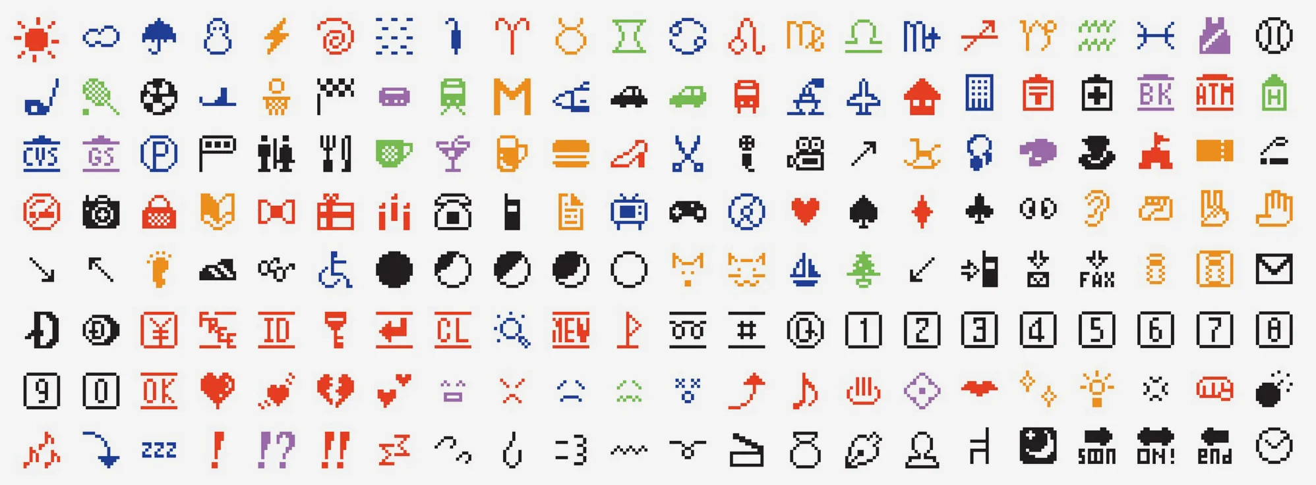
Late
1990s
1960s
1980s
:-) & :-(

Slide 4
🍙
👹
🍜
🎎
🍣
🎏
🍥
🎐

Slide 5


Unicode 6.0

Slide 6
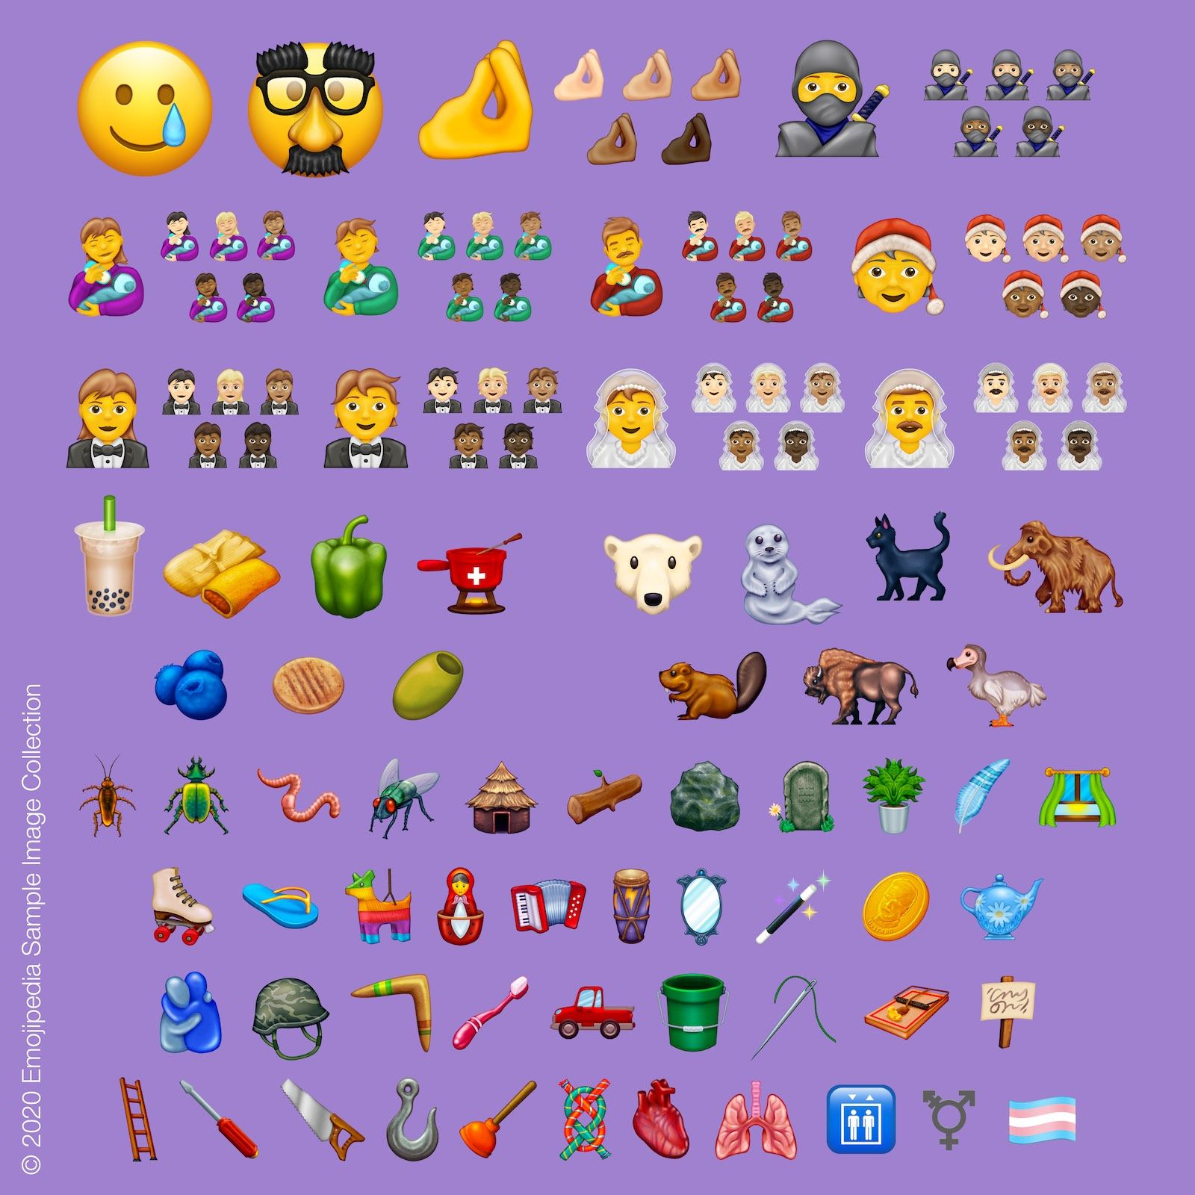

Slide 7
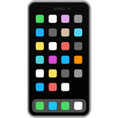
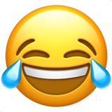

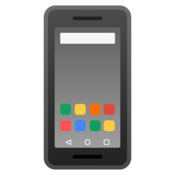


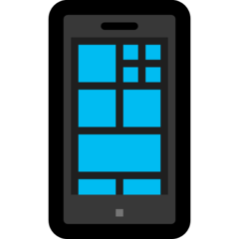


Apple
Twitter
Google
Facebook
Microsoft
Samsung

Slide 8
👩‍🏭
🦾
👨‍❤️‍👨
🦿
🦟
👩‍❤️‍👩
👯‍♀️
👨‍🏭
👯‍♂️
💑

Slide 9
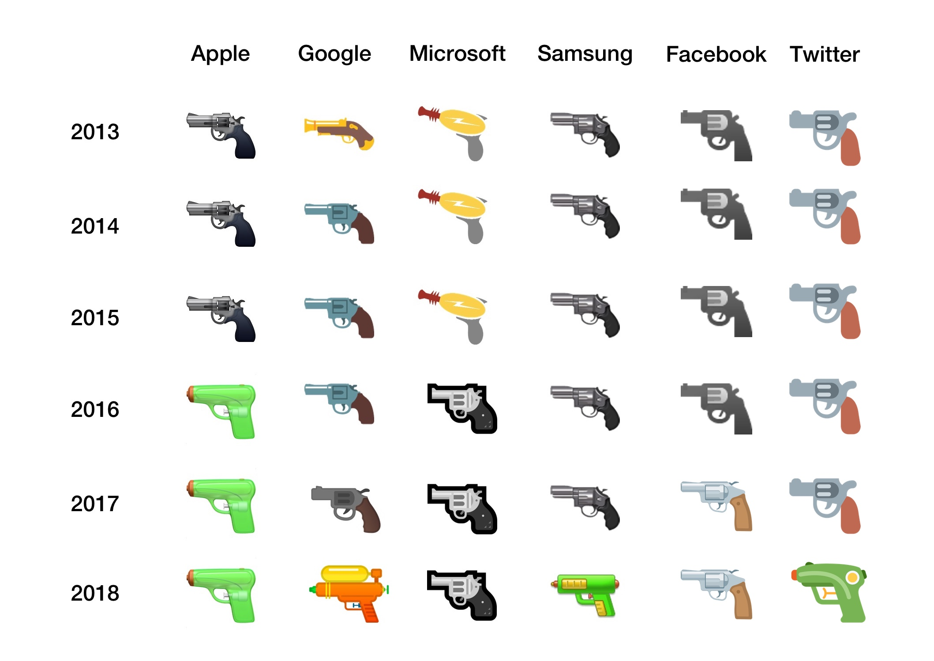

Slide 10
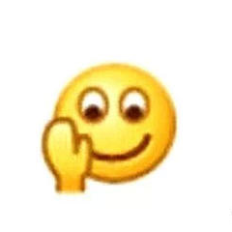



Slide 11

😂
Face with Tears of Joy

Slide 12
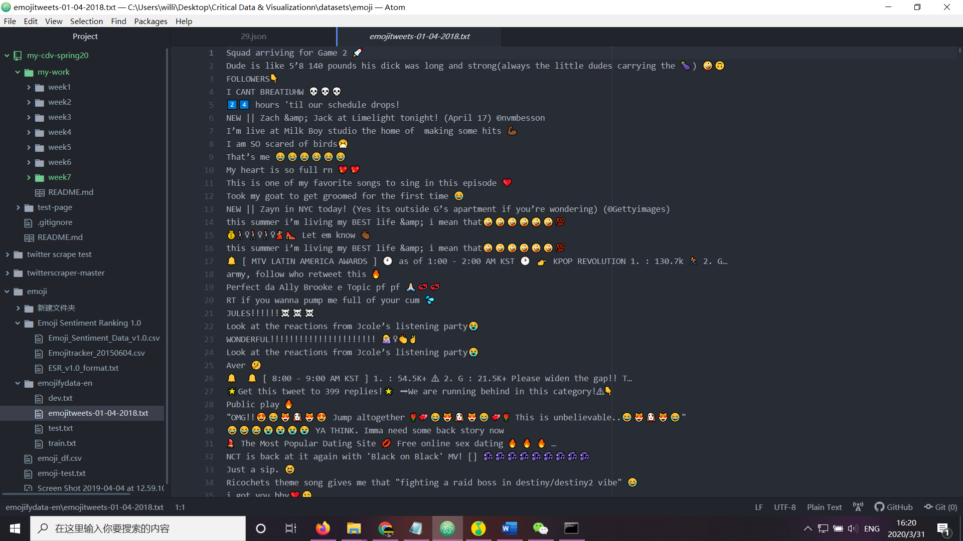

Slide 13
Text Sentiment vs. Emoji Sentiment

Slide 14
Combination & Frequency
🦅 & 🇺🇸
😂😂😂😂
(👼 & 💩)
❤❤❤❤

Slide 15
